Slide 1

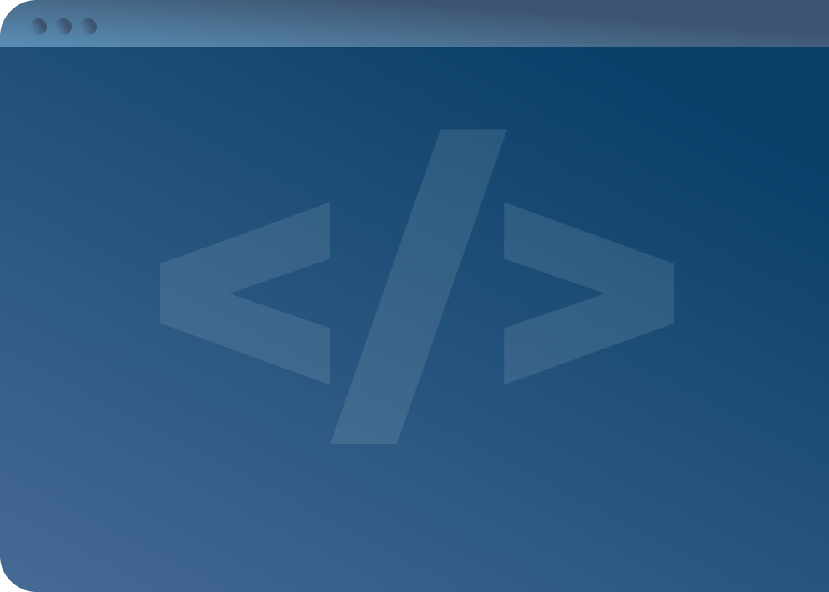

SOFTWARE DEVELOPMENT PROFESSIONAL PROGRAM
Functions

Slide 2





Functions
Learning Objectives
Employ functions to create reusable pieces of code.
Organize your code effectively using functions.

Slide 3
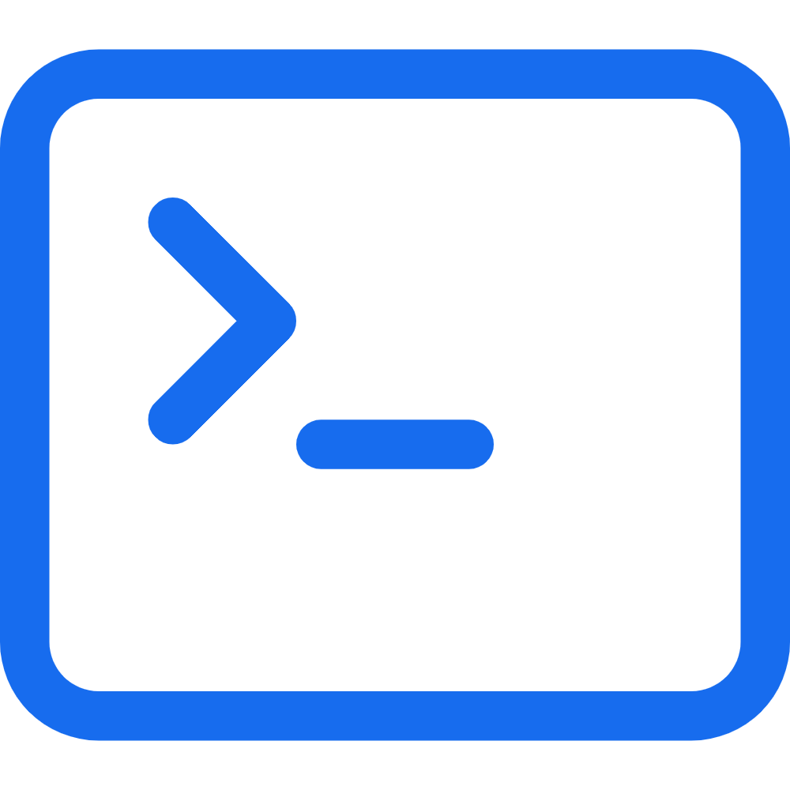
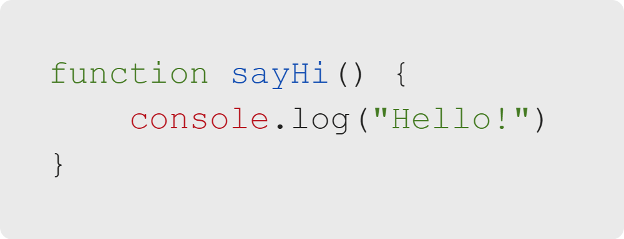
Functions
Functions
A function is a block of code designed to perform a particular task.
A function expression must have the following properties:
The keyword function
A function name
A pair of parentheses
A pair of curly braces
Notes:
Functions are a way of organizing your code into reusable snippets.
Function names have the same rules as variable names.
The parentheses may contain parameters, but we will discuss those later.
The curly braces will contain the code for your function.
<<Exercise 1: Define a function>>

Slide 4
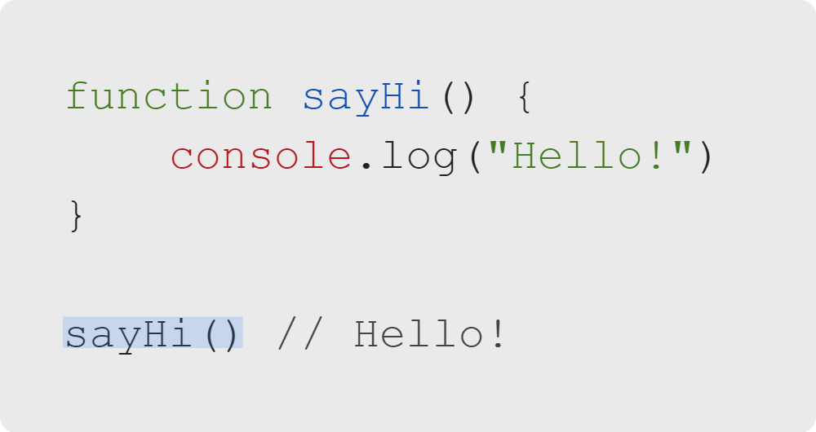
Functions
Calling a Function
To call (or use) a function, you write only the name with a pair of parentheses.
You may recognize this syntax, as you have already been using functions; the console.log() command is a function.
Notes:
A function is a reusable block of code, but how do you use it?
To use a function, you have to "call" it. You call a function by its name, with a pair of parentheses.
You can call a function as many times as you want after it has been defined in the code.
<<Exercise 2: Call a function>>

Slide 5
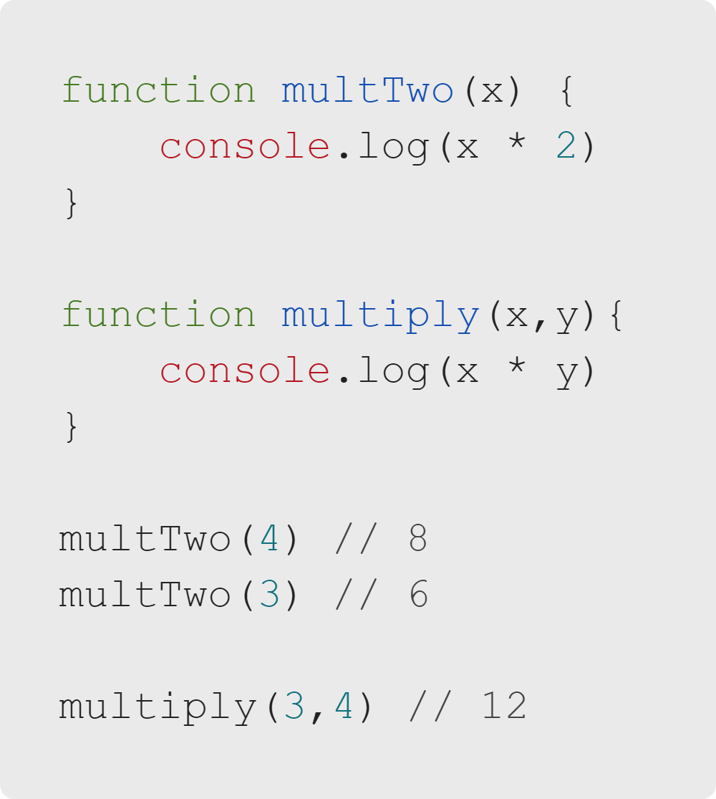
Functions
Parameters
Building on the necessary syntax, there are some additional things you can do. The first of these are parameters.
Parameters allow for inputs to the function.
You may include as many parameters as you want.
To use parameters, put the new value inside the parentheses when you call the function.
Notes:
Parameters allow you to change up what your function does.
Every time you call the function, it will behave according to the input it receives.
It is often a good idea to check what inputs people pass in (send as parameters); if you expect a number
and someone passes in a word, it can break what your function does.
<<Exercise 3: Define a function with a parameter>>

Slide 6
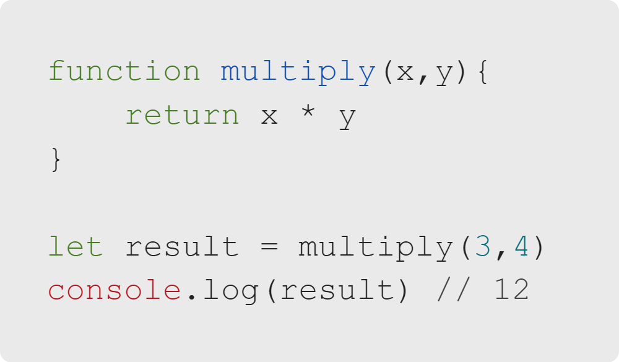
Functions
Return Statements
The second optional piece of a function is a return statement.
When the function reaches a return statement, it stops executing and goes back to where the function was called.
The value that is returned can be stored in a variable.
Notes:
You don't always want your functions to just log to the console.
Return statements allow you to compute and then store a value for later use.
This makes functions much more useful; now, you can ask a question and get a response based
on the value you submit, or make a calculation that updates based on your inputs.
<<Exercise 4: Define a function with a return statement--define a function that returns strings based
on the argument>>

Slide 7
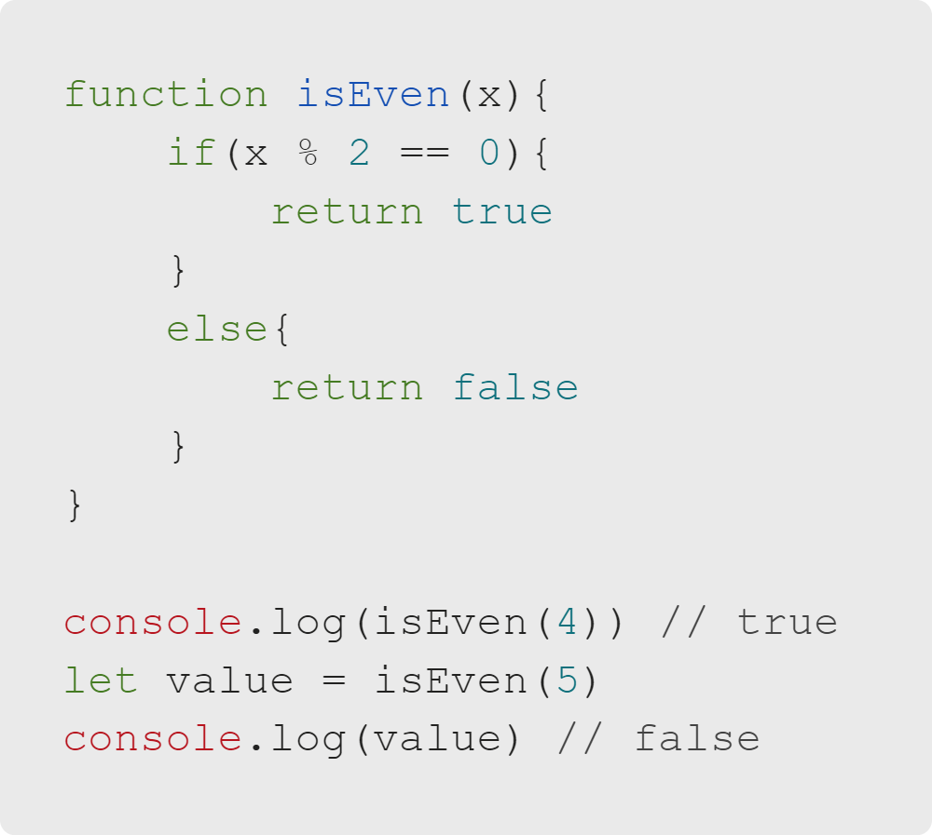
Functions
Using Functions
Parameters and returns can be combined with other code elements that you have learned, like conditionals.
You don't have to store the returned values in a variable to use them.
Notes:
You can use any element of writing code that you've learned so far in your functions.
Different tasks will require you to use loops, conditionals, and other elements within
functions that you write.
It is important that you name your functions with descriptive names, so that reading
the code that uses your functions is easy. In this example, the name 'isEven' is descriptive and
makes the function easy to use; the function simply returns true if the parameter passed in is an even
number, and otherwise it returns false.
<<Exercise 5: Use the return value from a function--use the return values of two functions to
customize a string>>

Slide 8
Functions
Organizing Your Code
Functions allow us to simplify our code.
Instead of repeating the same lines of code everywhere they are necessary, we can create a function.
This has the benefit of making your code more readable, as long as you name your functions well.
Notes:
Naming functions in a descriptive, concise way is a key skill for any developer.
Functions can make or break your code, both functionally and legibly.
Any time learners notice themselves writing the same chunk of code repeatedly, they should consider
whether writing a function makes sense.

Slide 9
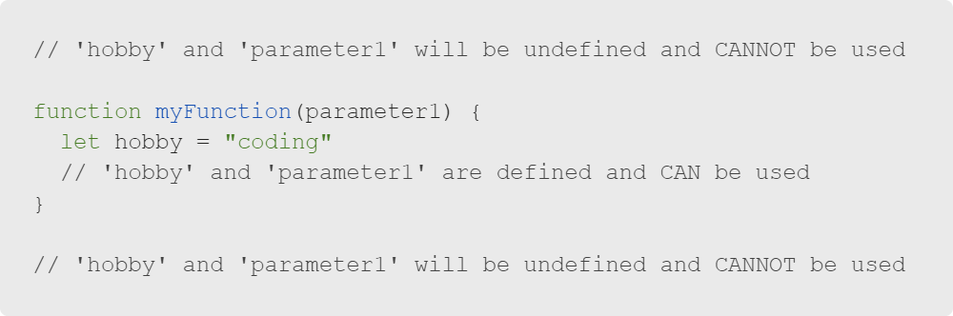
Functions
Scope and Function Variables
Scope refers to the place in your code where a variable is defined.
Curly braces can help you see where your variable exists. Because hobby in this example is defined inside of myFunction(), it cannot be used or even referenced outside of the function.
The same logic applies to parameter1. Because it is passed in to the function, the variable with the name parameter1 only exists within the function.
Every time the function is called, the local variables (that only exist in the function) are remade.
Notes:
Local variables are relative to the scope in which they are defined.
Because 'parameter1' and 'hobby' are both defined wihtin the function, they can't be
referenced outside of the function, and their values can only be accessed if
returned by the function.

Slide 10
Functions
Functions Review
Functions can help organize your code into more manageable and readable chunks.
Functions are defined with the function keyword, followed by the function name and a pair of parentheses that may or may not include parameters.
The code for the function is placed in curly braces and a return statement is optional.
Notes:
<<Make sure students feel comfortable with the concept of functions, both
defining them and using them to make their code more readable.>>

Slide 11


Functions
Career Spotlight
Career Spotlight
Notes:
We've learned a ton today haven't we?
Let's take a quick step back and remind ourselves what all this is for by taking a look at a potential career!

Slide 12
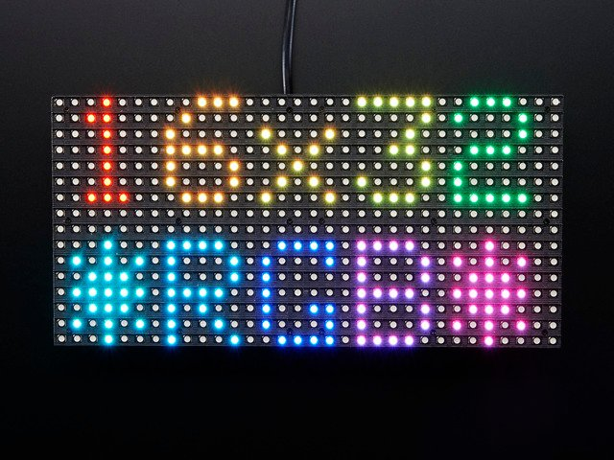
Functions
Wow Factor
A look inside the job:
Application Developer
Source: ADA Fruit
Notes:
Application Developer is a really generic term for someone who can program basically anything, from the web and
desktop to mobile and embedded systems.
In this image we see an LED screen attached to a very small computer known as a RaspberryPi.
You can program for RaspberryPi in (among other things) Python, which we will learn in the extended program.
The job of programming goes far outside the web. Don't limit yourself!

Slide 13


Functions
You've Got This
Today we learned about:
Functions
JavaScript Objects
Function Definition and Invocation
Parameter & Arguments
Return Statements
Scope & Variables

